Slide 1

CSS
Lesson 6

Slide 2
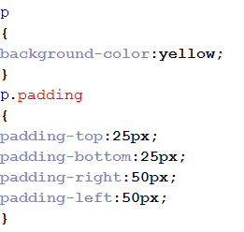
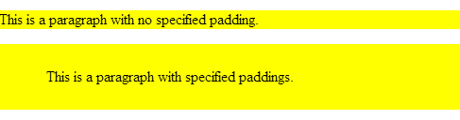
CSS Padding
The padding clears an area around the content (inside the border) of an element. The padding is affected by the background color of the element.

Slide 3
CSS Padding
The padding property can have from one to four values.
padding:25px 50px 75px 100px;
  top padding is 25px
  right padding is 50px
  bottom padding is 75px
  left padding is 100px
padding:25px 50px 75px;
  top padding is 25px
  right and left paddings are 50px
  bottom padding is 75px
padding:25px 50px;
  top and bottom paddings are 25px
  right and left paddings are 50px
padding:25px;
  all four paddings are 25px

Slide 4
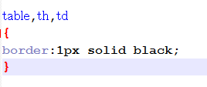
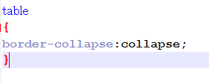
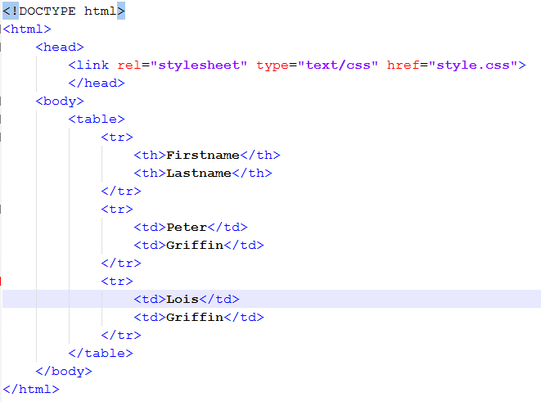
CSS Tables and Divs
style.css
Table border
Table border-collapse
doc.html

Slide 5

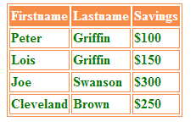
CSS Tables and Divs
Div
Table

Slide 6
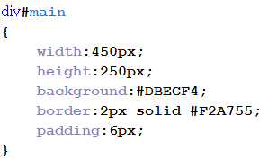
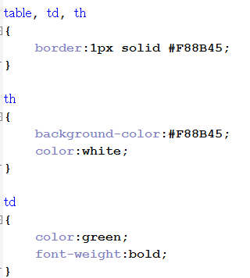
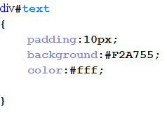
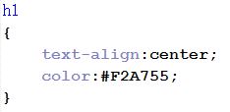
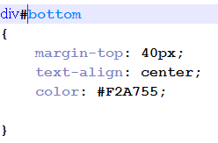
CSS Tables and Divs
Div
Table

Slide 7
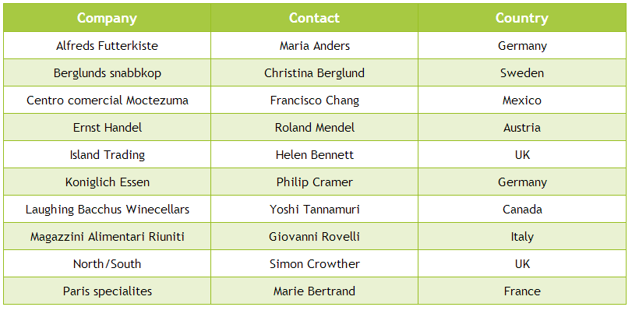
Task1:

Slide 8

Task2:

Slide 9

Task3:

Slide 10
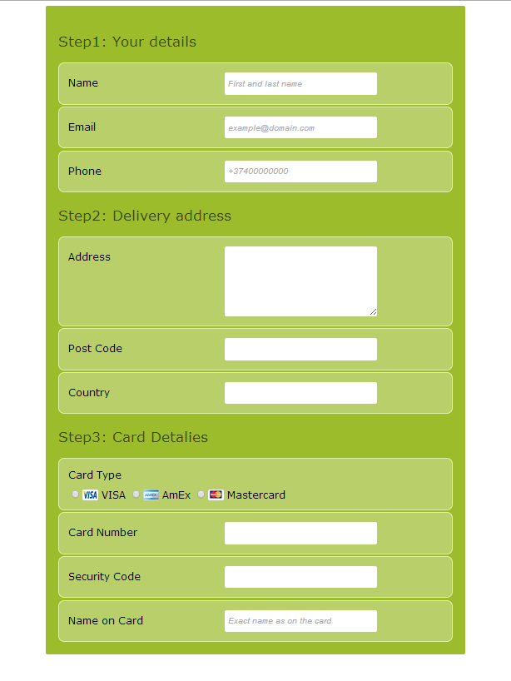
Task4:

